Slide 1
Economic, Environmental, and Societal Issues In Materials Science and Engineering
Ismael Colmenero Quintanilla-18889335 Iae

Slide 2
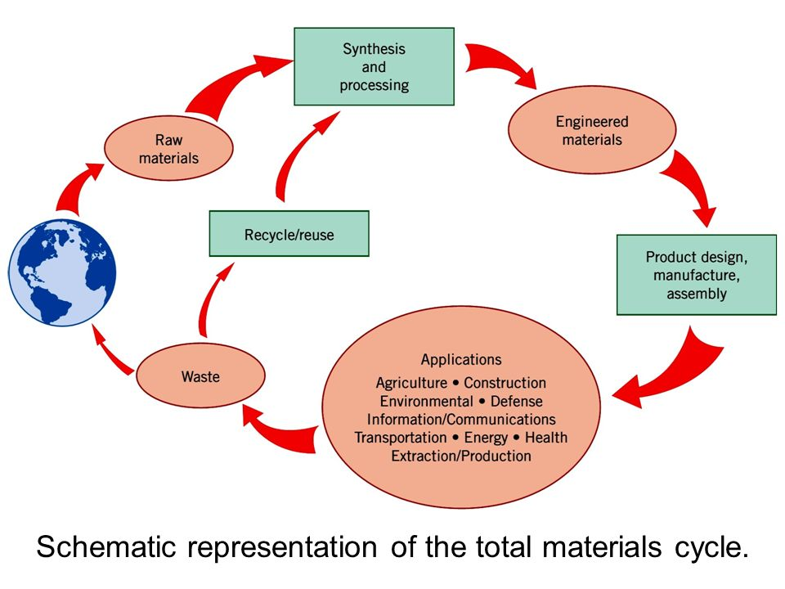

Slide 3
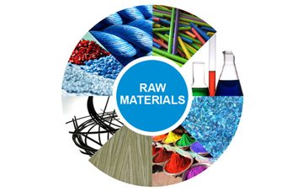
Raw materials issues
Basic substance in its natural, modified, or semi-processed state, used as an input to a production process for subsequent modification or transformation into a finished good.
The raw-material issue directly related with industrial, agricultural and household waste. The last category is domestic waste or debris.

Slide 4
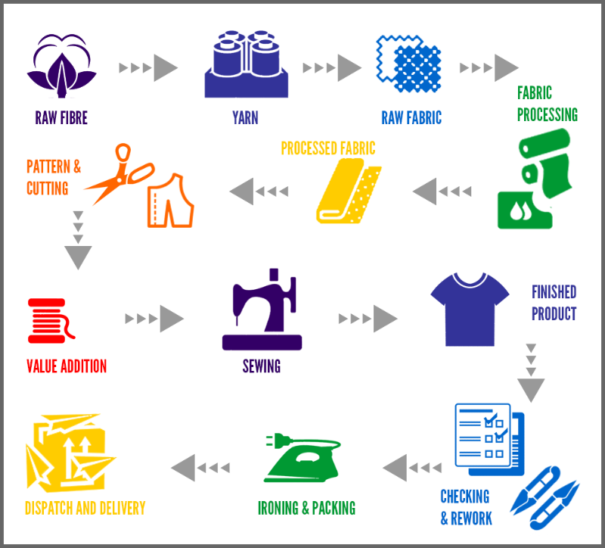
Synthesis an processing
Process in which substances combine to form completely new substances or duplicated natural products. In industrial synthesis, hydrocarbon molecules are combined in various combinations to numerous types of plastics and other new compounds.

Slide 5
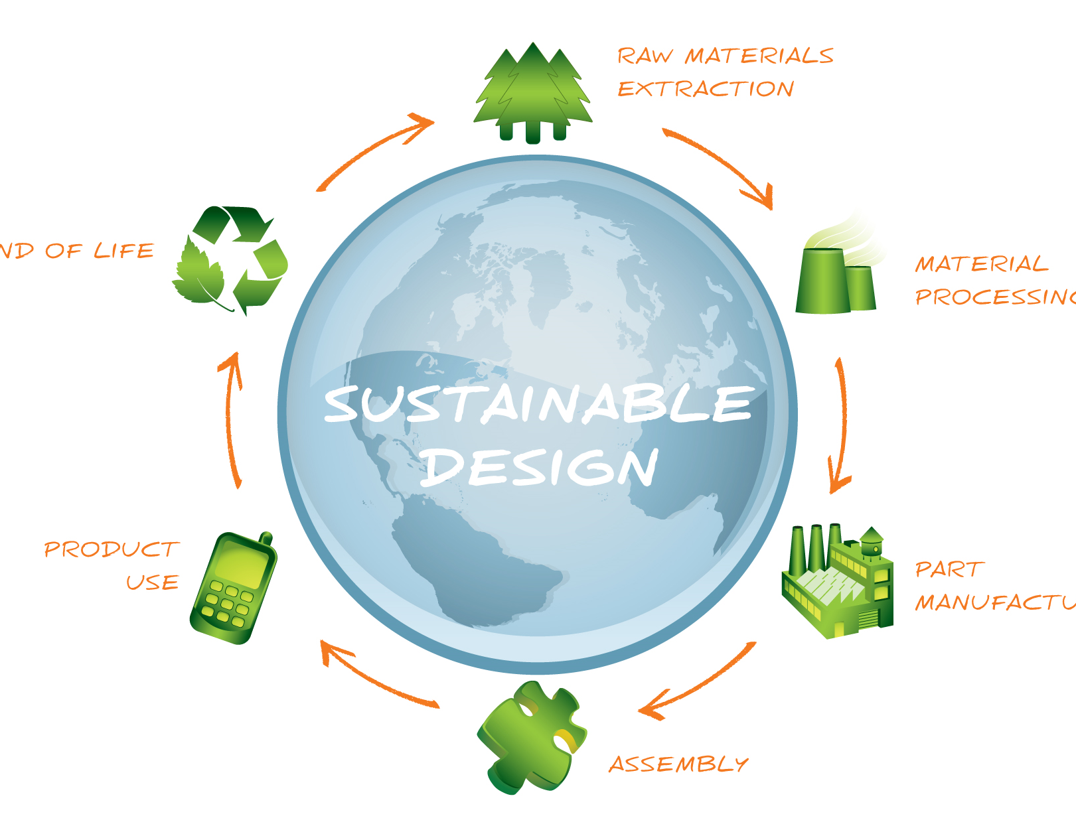
Green Design
Green design is the ‘creation of products which are energy-efficient healthy, comfortable, flexible in use and designed for long life’. Green design should have a minimal impact on the environment, both in terms of products and materials.

Slide 6
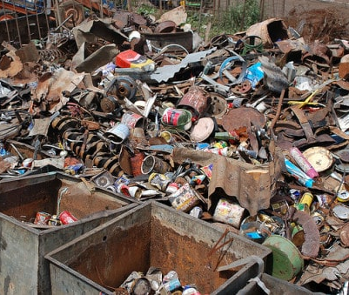
Recyclability of metals
1. Collection
2. Sorting
3. Processing
4. Shredding
5. Melting and Purification
6. Purification
7. Melting and Solidifying of the Metal
8. Transportation of the Metal Bars

Slide 7
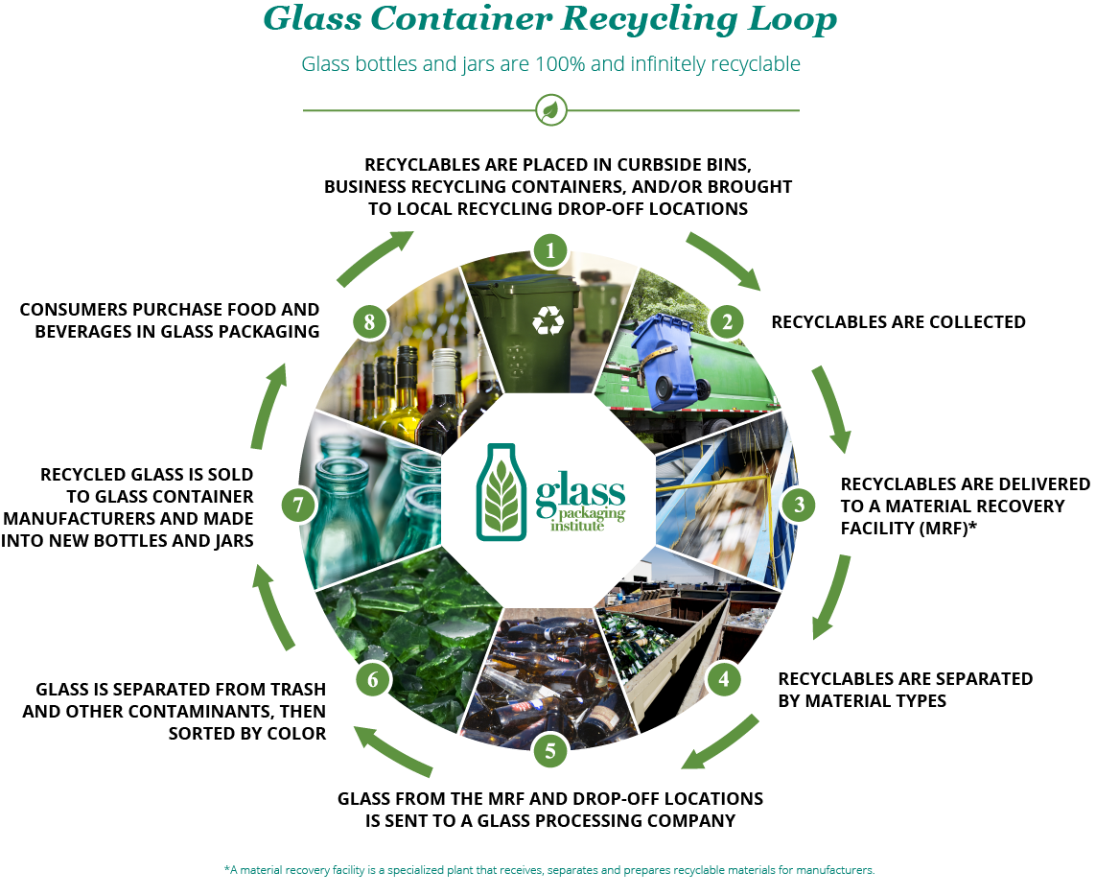

Slide 8
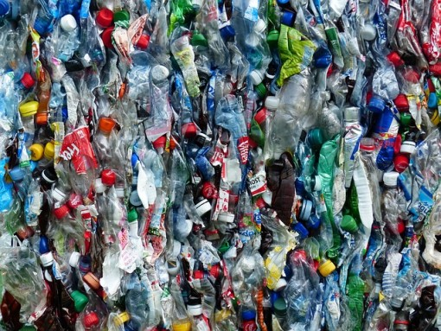
Plastic and rubber
1. Collection
2. Sorting
3. Shredding
4. Cleaning
5. Melting
6. Making of pellets

Slide 9
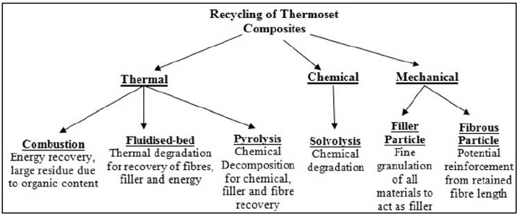
Composite Recycling
Composite materials are used in a wide range of applications such as automotive, aerospace and renewable energy industries. But they have not been properly recycled, due to their inherent nature of heterogeneity, in particular for the thermoset-based polymer composites.
Various technologies, mostly focusing on reinforcement fibers and yet to be commercialized, have been developed: mechanical recycling, thermal recycling, and chemical recycling.

Slide 10
Sources
https://www.synthx.com/articles/pdp2-requirements.html/
http://www.businessdictionary.com/definition/raw-material.html
http://www.businessdictionary.com/definition/green-design.html
https://www.thenbs.com/news/what-is-green-design-and-what-are-the-steps-to-achieving-it
https://www.conserve-energy-future.com/recyclingmetal.php
http://www.recycling-guide.org.uk/science-glass.html
https://www.conserve-energy-future.com/recyclingplastic.php
https://www.sciencedirect.com/science/article/abs/pii/S0255270111002029
http://www.businessdictionary.com/definition/synthesis.html
http://www.globaltrouble.com/raw_material_problem.html

